Slide 2
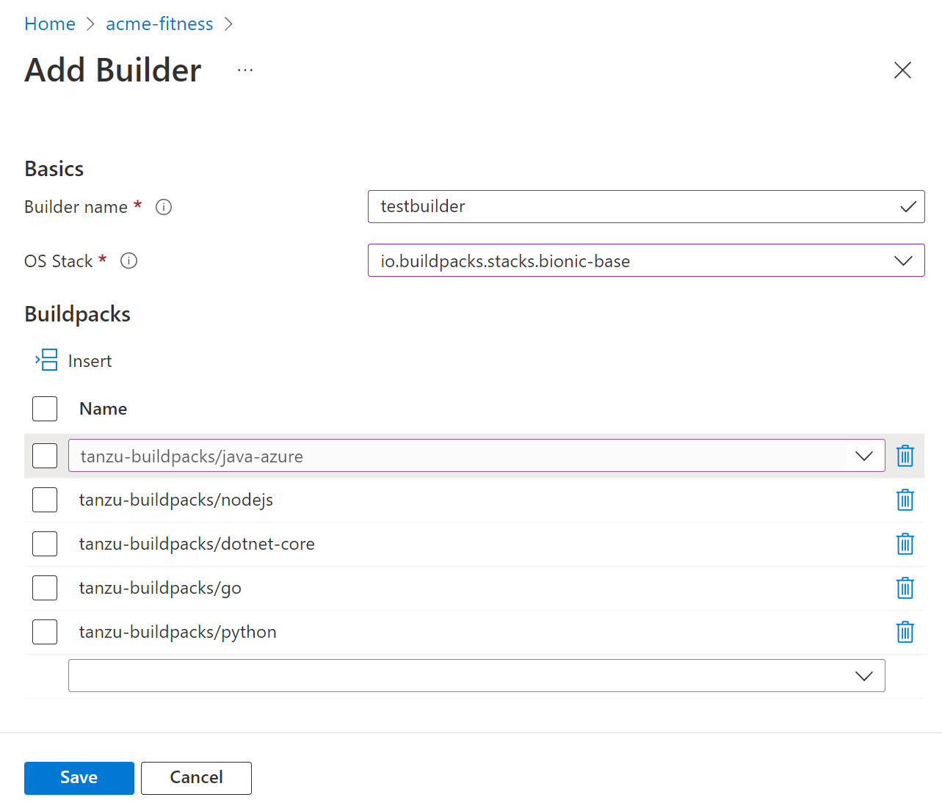

Slide 3
Check in 1 – Review learnings
5 mins
Notes:
Speaker: Asir

Slide 4
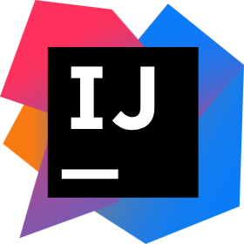











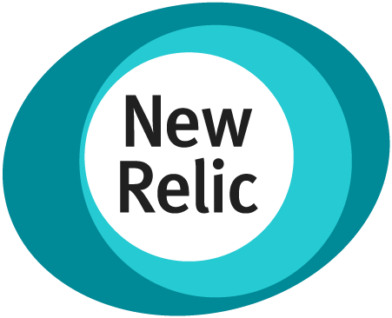
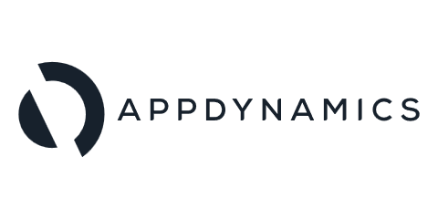



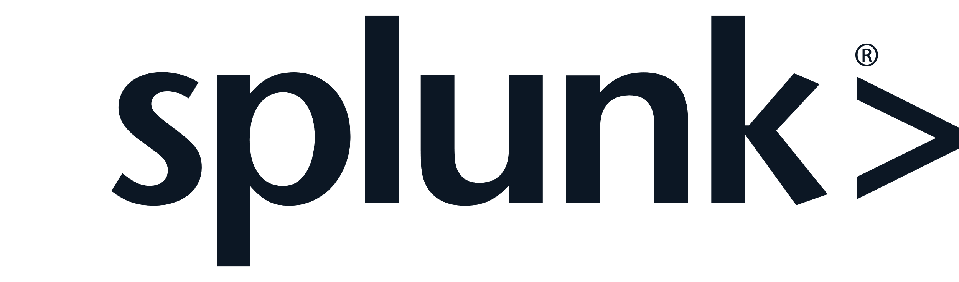
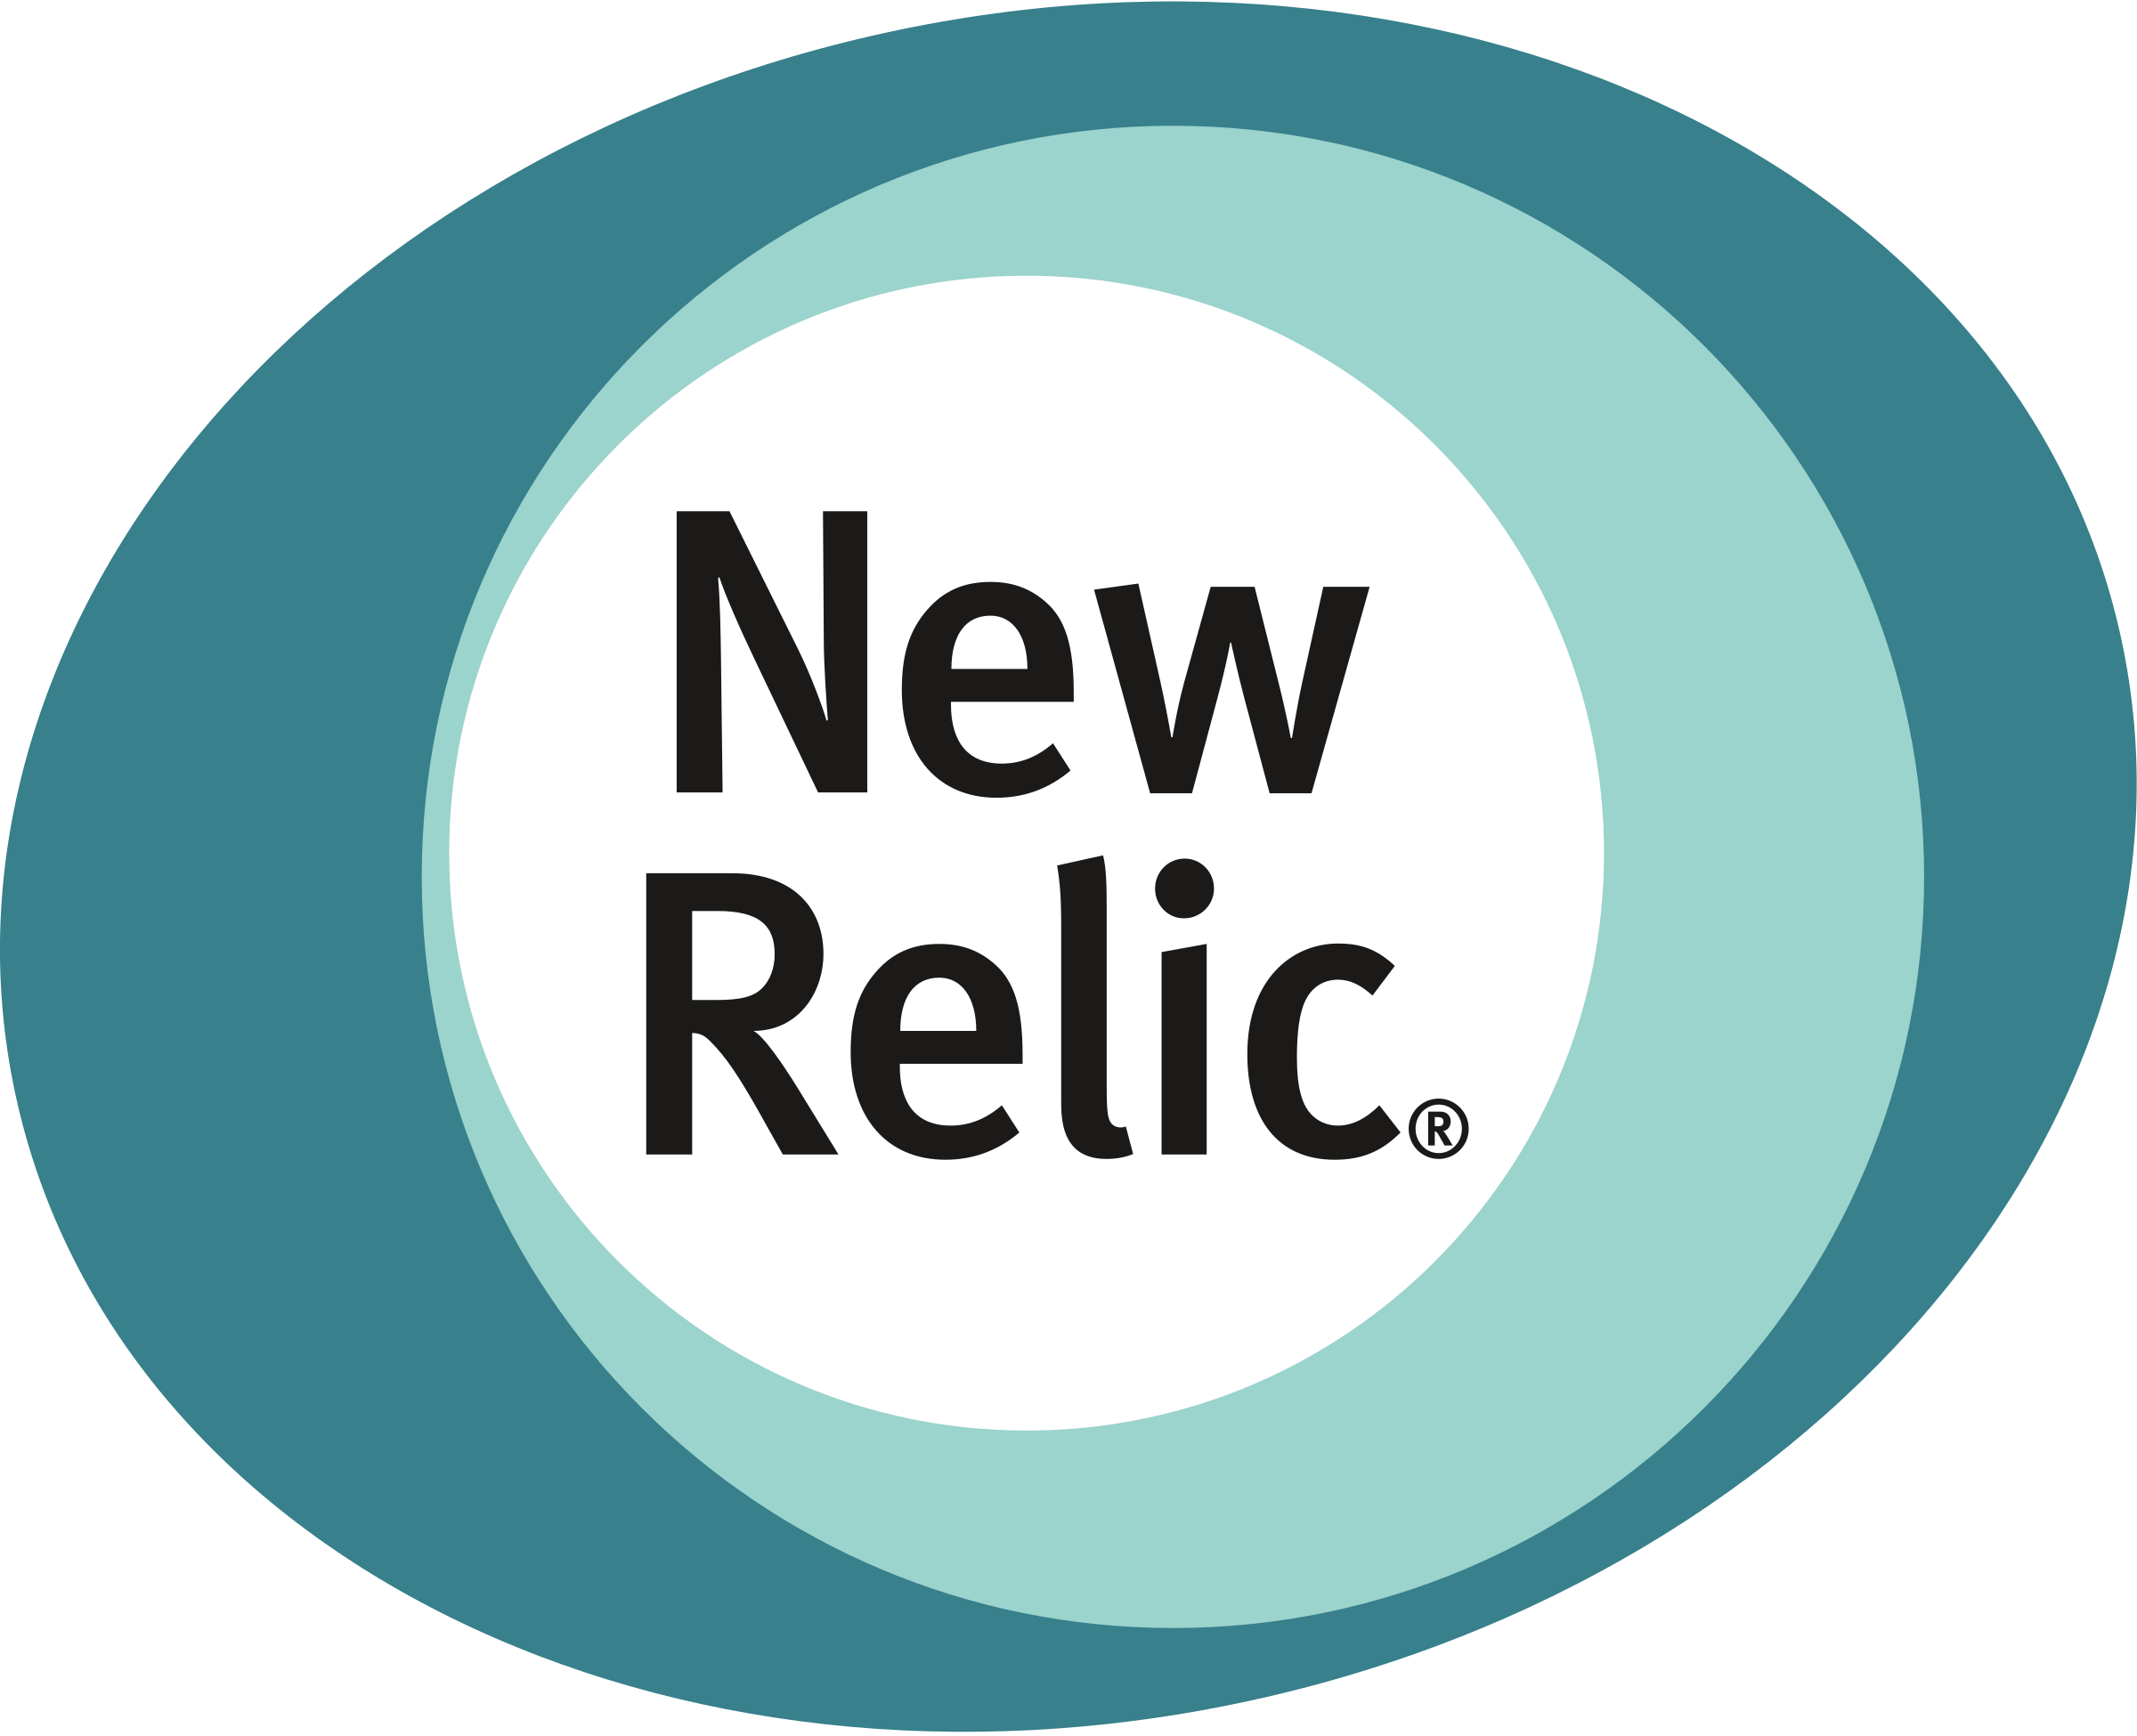













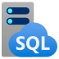









Azure Spring Apps (slide 7 of 7)
Developer experiences
Monitor – logstream, APM, & end-to-end
Identities – end-users & machines
Automation
Azure Spring Apps
Spring Boot Apps
Service runtime
Open-source client libraries, integration modules, and drivers
Data
Storage
Cache
Async communications – JMS and Kafka
Keys, secrets, and certs
Notes:
A few more details …
The big rectangle is Azure Spring Apps, built on K8S.
Each service instance has two dedicated Kubernetes clusters. They are managed by Azure Spring Apps and removed from users.
Service runtime with managed Spring Apps components, app lifecycle, log streaming, and many more service runtime components are managed in the right side of the Kubernetes cluster.
Your apps are running in the left cluster of the diagram.
<CLICK>
Your apps can interact with any Azure service or external service or on-premises system.
<CLICK>
Logs, metrics, and alerts are available through Azure Monitor. You can monitor end-to-end, using any tools and platform of your choice.
<CLICK>
You can secure your apps using Azure Active Directory.
<CLICK>
Automate end-to-end, using your favorite tools and platforms.
<CLICK>
You can continue to use the development tools you are familiar with – IntelliJ, VS Code, Maven, Gradle. You can deploy using tools like IntelliJ and Maven.
Net-net – it is an easy way to get started, focus on your biz objectives, and everything else is taken care of for you in the cloud.
<CLICK>
Do you have to manage anything here?
No, you do not … Azure Spring Apps has absorbed all the complexities with infrastructure, hosting microservice apps, app lifecycle, managing microservices, blue green deployments, pushing logs, and metrics.
All supported by Microsoft and VMware.

Slide 5
Azure Spring Apps in a nutshell
Developers Easily build and deploy
IT Operators Simple to operate at scale
Executives Peace be with you!
Build and scale distributed workloads at cloud scale.
Externalize config, enable service registry, secure, automate end-to-end and monitoring.
Harness the power of K8S without learning or operating it.
Easy to spawn environments.
Automate testing.
Advance to production across the globe.
Home for distributed workloads that leverages services on Azure, on-premises, and externals.
Eliminate middleware management efforts – say patching, running middleware, etc.
Unlimited scale without additional hardware procurement or datacenters.
Define roles and responsibilities to match your team structure – Azure RBAC (developer, DevOps, SRE, tester, security).
Monitor end-to-end – detect and react faster.
Automate end-to-end.
Implement charge backs in line with your funding model – through Azure cost management system.
Minimize costs.
High availability through unpredictable volumes and recover faster from failures.
Expand across the globe – 60+ Azure regions with speed and scale to meet your needs.
Strengthen your security posture with Azure.
Supported by Microsoft and VMware.
Notes:
In brief – There is something for everyone.
If you are a developer – you can:
Build and scale workloads at cloud scale, you can easily apply cloud-friendly patterns such as externalized configuration, service registration, and discovery, automating and monitoring end-to-end.
Get the full power of K8S without touching it.
Create any number of environment, automate testing and advance to production across the globe.
If you are in the IT team – you can:
Operate the service and environments at scale:
The service becomes the home for distributed workloads; you can connect with services running on Azure or on-premises or anywhere.
As you operate, you do not have to worry about middleware management.
Get unlimited scale.
Align your team’s roles and responsibilities to match your team structure using Azure RBAC
Apply policy management.
Monitor and automate end-to-end.
Also, implement charge-backs in line with your funding model.
If you are an executive:
You have the essential need to minimize total cost of ownership, high availability, and plenty of head room to grow the workload.
You can harden your security using Azure’s security and be fully supported by Microsoft and VMware.
© 2022 VMware Inc. and Microsoft Corporation. All rights reserved. MICROSOFT MAKES NO WARRANTIES, EXPRESS, IMPLIED OR STATUTORY, AS TO THE INFORMATION IN THIS PRESENTATION.

Slide 6
Part 2
Typical app architecture and Polyglot apps

Slide 7

Typical application architecture
10 mins
Runtime
Frontend User Interface
API Gateway
Backend APIs
Automation
Monitoring
Identity Provider
Databases for Business State
Secrets Management
Notes:
To demonstrate the capabilities of Azure Spring Apps Enterprise, let’s consider a typical application with a frontend user interface and one or more backend APIs.
Such as application will need:
API gateway to route traffic to the correct components of the applications, and to enforce cross-cutting concerns, such as API endpoints that require the user to be logged in.
Identity provider that can be used to log in users into the application.
One or more databases for each of the backend APIs that are part of the application.
Comply with information security policies that all sensitive configurations, such as passwords, and API keys, be stored in a secure secrets management solution.
We will also need a way to implement continued delivery for the application and its components, so we will need great solutions for:
Automating for deploying the application.
Monitoring to support troubleshooting, planning capacities, and keeping an eye on production.
Runtime that can auto-scale application components based on demand.

Slide 8

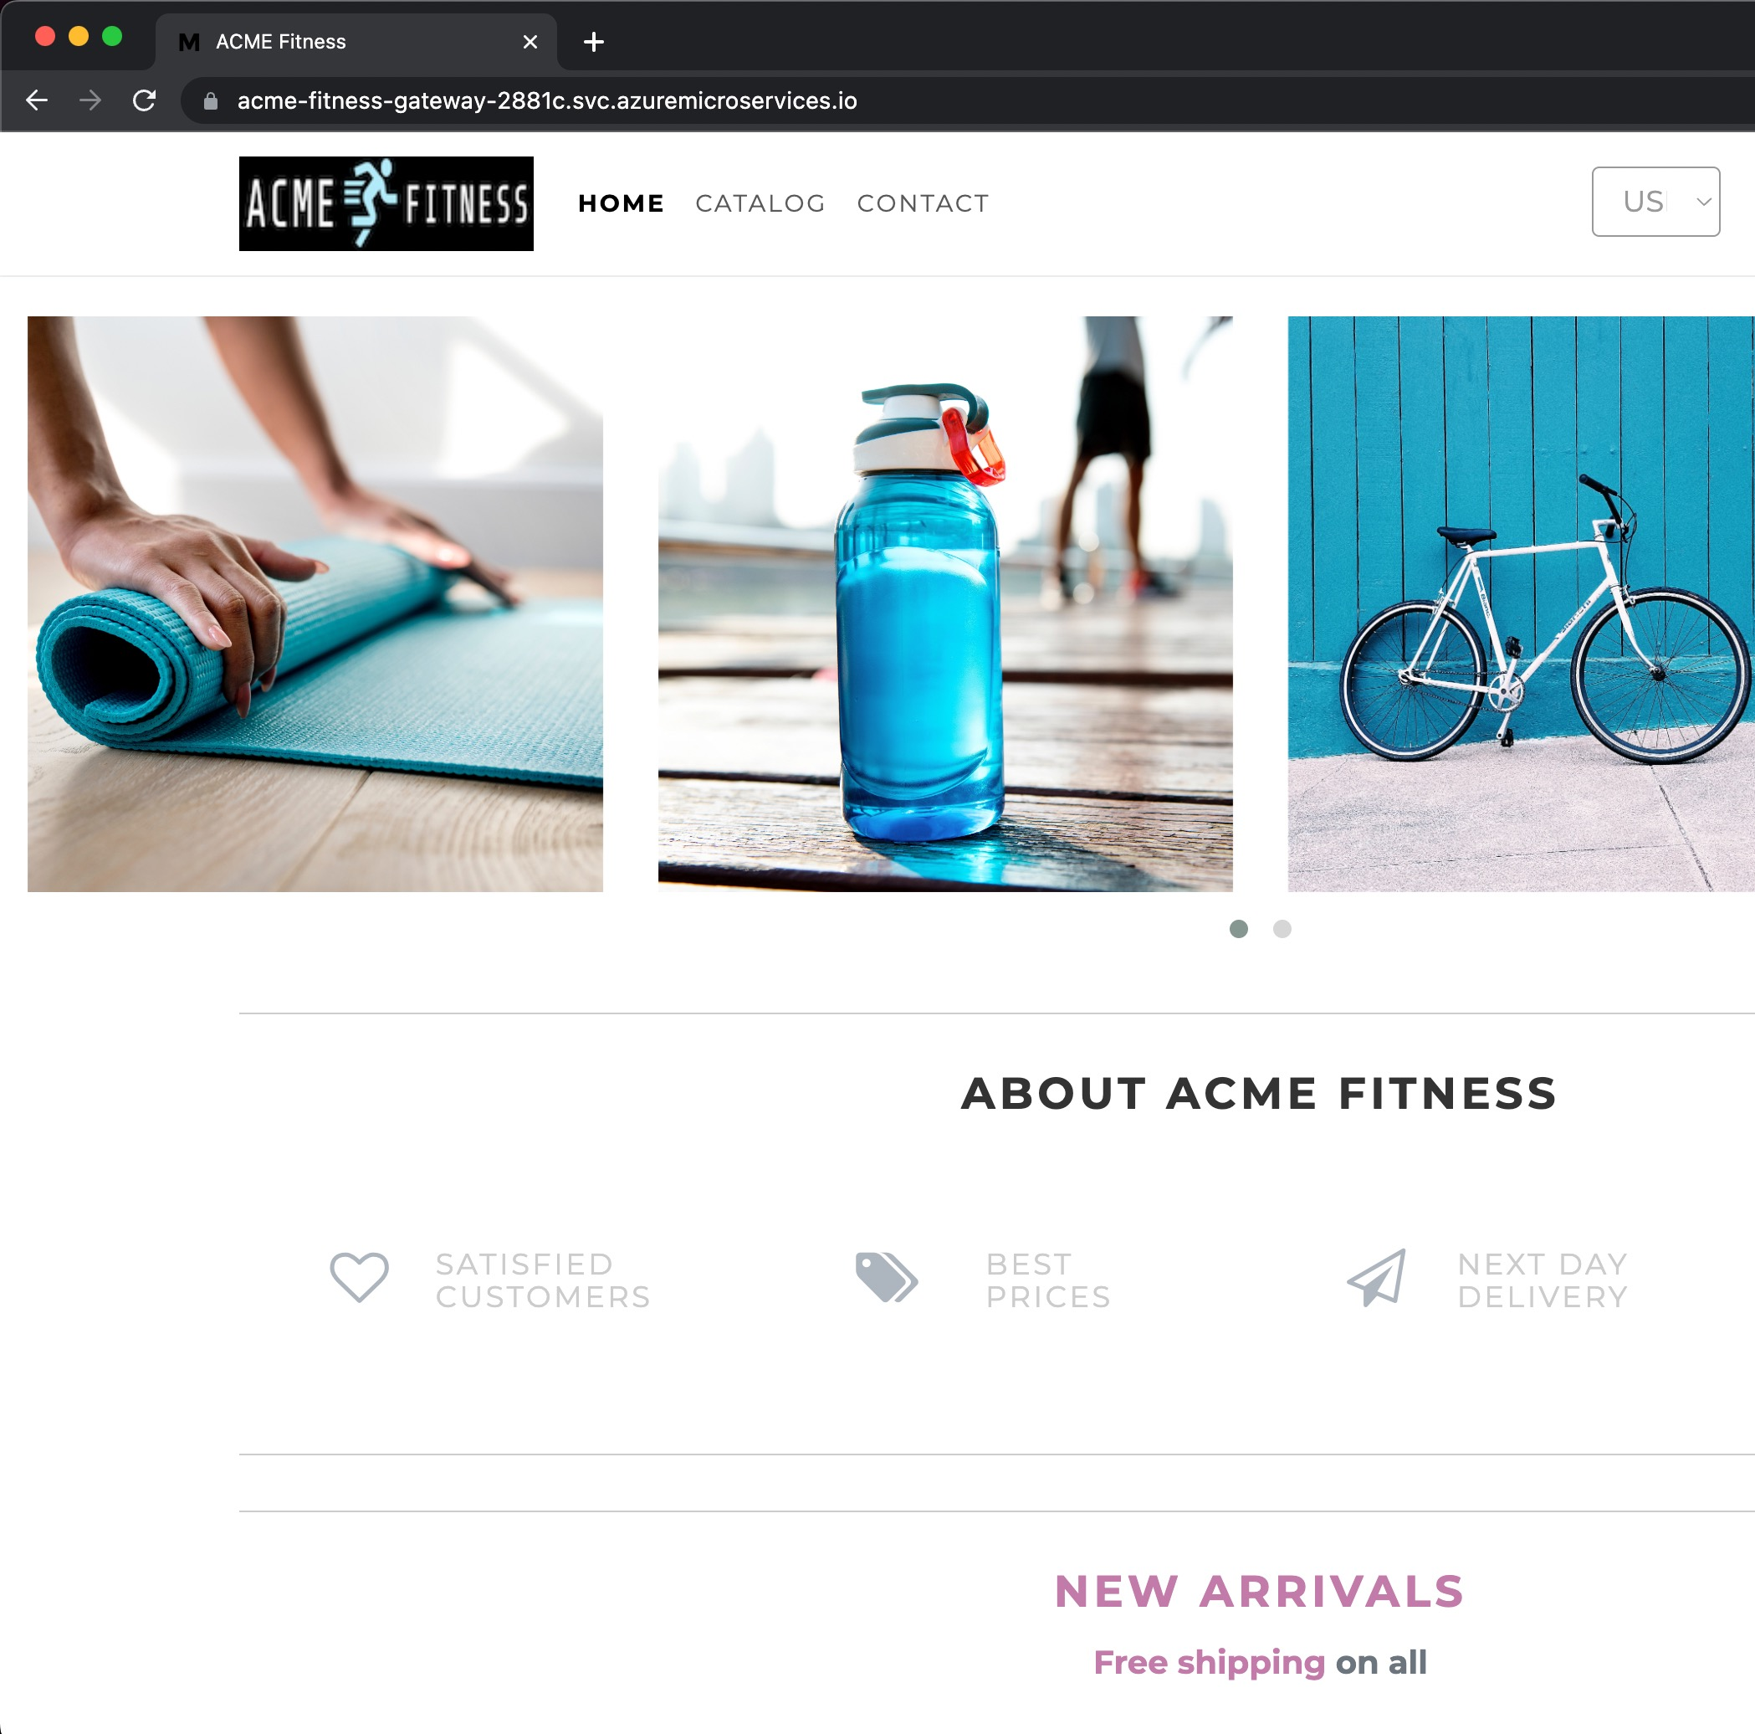
Acme Fitness
aka.ms/fitness-store
Notes:
We will now go through a demo of the functionality of the ACME store application that implements the typical architecture we just discussed, so we can zoom in on each of the capabilities of Azure Spring Apps Enterprise.
[Place demo video 00:00 to 01:17 after this slide]

Slide 9



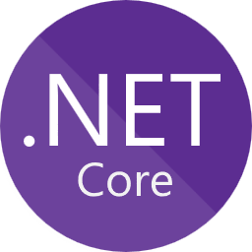

Common app architecture
Azure Spring Apps
Frontend: NodeJS
Spring Cloud Gateway
Backend APIs
Identity
Catalog
Payment
Cart
Order
Automation
Monitoring
Azure Active Directory
PostgreSQL
Key Vault
Notes:
ACME fitness is a polyglot application that has V written in:
Primarily Java Spring Boot API.
Secondary services are in Python and C#.
Java Script and HTML5 UI.
Spring Apps Gateway with commercial filter is used to route traffic and secure the endpoints of the applications.
Azure Active Directory is used as the identity provider to manage logins into the application.
PostgreSQL is used as the backend database for the various APIs.
Azure Key Vault is used to store the application secrets.
Azure Spring Apps Enterprise is used to easily automate application deployment, motioning, and scaling.
Let’s now see how to create an instance of Azure Spring Apps Enterprise and how to deploy apps to it.

Slide 10
Tour Acme Fitness Store
Deployment in Azure
Code base

Slide 11
Deploy NodeJS frontend
What is Spring Cloud Gateway?
Deploy backend APIs
Connecting apps to data services
Manage credentials in Key Vault
Configure SSO
Visualize requests
5 mins

Slide 12
Spring Cloud Gateway
15 mins
Notes:
Speaker: Adib

Slide 13
Understanding the Spring Cloud Gateway building blocks
Let’s start with a route and understand how the gateway helps me with XCCs
Routes define how the Gateway will process incoming requests.
Each route is composed of Predicates, Filters, and a Service.
Predicates determine whether the route matches any given request.
Filters apply behavior to matching requests or their responses.
The Service determines where the request will be forwarded after filtering.
Link to Spring Cloud Gateway doc
Notes:
The core concept in Spring Apps Gateway is the route.
A route defines how Spring Apps Gateway will process an http request.
Each route consist of three parts
Predicate
Filter
Service
The Predicate defines the logic test to determine which route an incoming http request will pass through. For example, an HTTP POST to the /api/checkout url can be defined as a Predicate.
The Filter defines the processing logic for a request. For example, it requires the user to be logged in or perform rate limiting.
The Service determines where the request will be sent after the filtering is completed.

Slide 14
How they all work − Spring Cloud Gateway
The logic for executing the cross-cutting concerns
Spring Cloud Gateway
Pre-request
Filter
Filter
Filter
Proxy Filter
Gateway Handler Mapping
Gateway Web Mapping
Proxied Service
Post-request
Filter
Filter
Filter
Proxy Filter
Client makes a request to the Gateway.
Evaluates Predicates to match a request to a route.
Runs through the “pre” filter logic chain specific to the request.
Proxy routes the request to the service.
Service is executed.
Runs the “post” filter logic.
Notes:
You can visualize how Spring Apps Gateway works using the diagram showing the steps of request processing.
Steps include:
Client makes a request that is routed by Azure Spring Apps to Spring Apps Gateway.
The Gateway evaluates the Predicates to match a route to process the request.
The Gateway runs the request through all the pre-request filters to manipulate the request before it is forwarded to the proxied server.
For example, it can apply a rate limiting policy; if the request is within the rate limit, it will be forwarded to the proxied service, otherwise an error code is returned.
The service is invoked, and it returns a response.
The response is run through a set of post-processing filters, and it makes its way back to the client that made the request.

Slide 15
Spring Cloud Gateway Predicates
Evaluate conditions to map requests to a route
After a certain datetime?
Before a certain datetime?
Between two datetimes?
Cookie matches a regex?
Header value matches a regex?
Host matches a pattern list?
HTTP Method matches a list?
URI Path matches a pattern?
URI Query matches a regex?
RemoteAddr matches CIDRs?
Weight within a route group
Link to available Predicates
Notes:
Spring Apps Gateway allows you to match http requests using a rich set of options. For example, you can match http requests by:
http Cookie
http Headers
http method
The path parameter of the:
Query parameters
And time when the request arrived
There is a very rich Predicate configuration that allows you to easily match against http requests.

Slide 16

Spring Cloud Gateway Filters
Allow you to do things with requests/responses
Add, remove, modify headers; map values; add security headers.
Rewrite path, extract segments, add / remove prefix.
Redirect users.
Retry and use Circuit Breaker.
Change response status.
List authorized roles and scopes to access route.
Link to available Filters
Notes:
[Read what’s on the slide.]

Slide 17
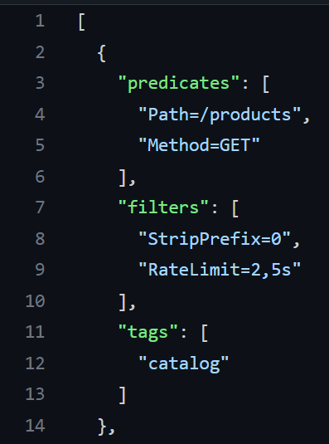
Spring Cloud Gateway – Rate Limiting Filter
Allows you to limit number of requests
The Rate Limiting Filter limits the number of requests allowed from a route, with the ability to burst the limit to a max number.
Duration specified in seconds(s), minutes(m), or hours(h).
Within limits: response will succeed + report how many requests can still be made.
Exceeded limits: fail with 429 Too Many Requests.
Ex.: Limit users to 2 requests every 5 seconds.
Link to Rate Limit Filter
Notes:
On Azure Spring Apps, you can configure Spring Apps Gateway using a json file.
The json snippet you see configured /products endpoints to allow only 2 requests every 5 seconds.
Lines 3 to 6 define the predicates in this case that the url path is /products and that the http method is GET.
Lines 7 to 10 define the filter logic that should be applied to a matching request, in this case to:
Remove the first part of the url.
Apply a rate limit of 2 requests every 5 seconds.
The docs provide lots of details of all the filters and predicates that you can use.

Slide 18

Demo 2 Deploy frontend
Deploy NodeJS frontend app
Configure Spring Cloud Gateway
Notes:
Speaker: Asir

Slide 19
Lab 2 Deploy frontend
Deploy NodeJS frontend
Configure Spring Cloud Gateway
Validate URL
10 mins

Slide 20
Configuration Services
5 mins
Notes:
Speaker: Adib

Slide 21
Problem Context
A service is deployed to multiple environments (dev / qa / prod) with configuration differences between environments.
Multiple instances of a service run in each environment to meet scalability and availability requirements.
Risk Management requires an audit trail of every configuration change made.
Infosec requires credentials to be encrypted or stored in a dedicated vault.
Need to able to roll back/forward configuration changes.
Need to produce reports on how things are configured in a specific environment.
Update an app configuration without having to restart it.

Slide 22
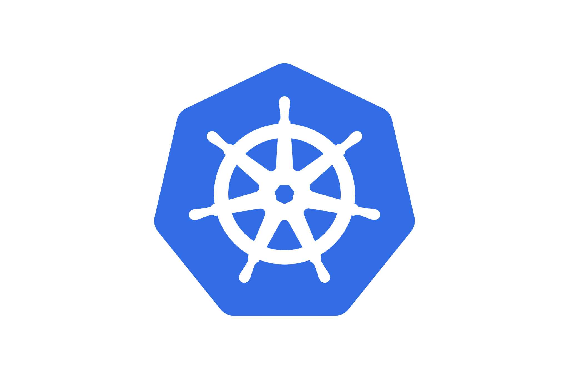

Two ways to handle app configurations and secrets
Kubernetes Native Configuration
Spring Cloud Configuration Server

Slide 23
The Spring Cloud Solution
Configuration Storage Backend
Service
A
Git Repository
Spring Cloud Configuration Server
Credential Vault
B
Config Server
Source of truth for service configuration.
Mediate access to multiple configuration storage systems.
The only network address that an app needs to know about.
filesystem
On startup, connect to config server to obtain config settings.
Access config server via HTTP / REST / JSON interface.
SQL Database
Other … etc.

Slide 24
Spring Cloud Config Features
Centralized Configuration Server
Pluggable Backend Configuration Storage Model
Encryption and Decryption of config values
Push Notifications with Spring Cloud Bus
Serve out text files with interpolation

Slide 25
Spring Cloud Config Server Pros and Cons
Pros
Cons
Has versioned/audited history of configuration settings.
Pluggable external stores (vault, sqldb, other config servers).
Runs locally; no developer desktop directly from IDE.
Does not depend on Kubernetes; developer does not need to know anything about K8S to use config server.
Store configurations for multiple apps in one config server.
Config is backed up outside of Kubernetes cluster.
Defines a hierarchy of property sources; allows extraction into a common property file in the config server.
Can be used outside of K8S or in a multi-cluster configuration.
Application can’t start up if config server is down.
Application must understand the config server REST API or use a client library.
Considered Java/Spring-centric by other language communities.

Slide 26
The Kubernetes Native Solution
ConfigMap
apiVersion: v1
kind: ConfigMap
metadata:
name: game-demo
data:
# property-like keys; each key maps to a simple value
player_initial_lives: "3"
ui_properties_file_name: "user-interface.properties"
# file-like keys
game.properties: |
enemy.types=aliens,monsters
player.maximum-lives=5
user-interface.properties: |
color.good=purple
color.bad=yellow
allow.textmode=true
Secrets
kubectl create secret generic my-secret --from-literal=key1=supersecret
--from-literal=key2=topsecret

